Slide 1
What was Happening to Hydroclimate over the Holocene??? Question Mark?

Slide 2
Notes:
Match colors with those on map.
Maybe add (resolution = x-years) tp legend

Slide 3
Data Sources

Slide 4
Data Management
LiPD files
Climate (P/P-E) and seasonality (annual, winter, summer) interpretations

Slide 5
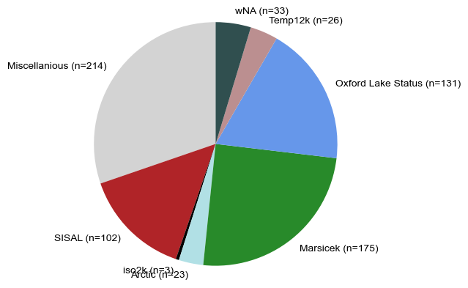

Slide 6
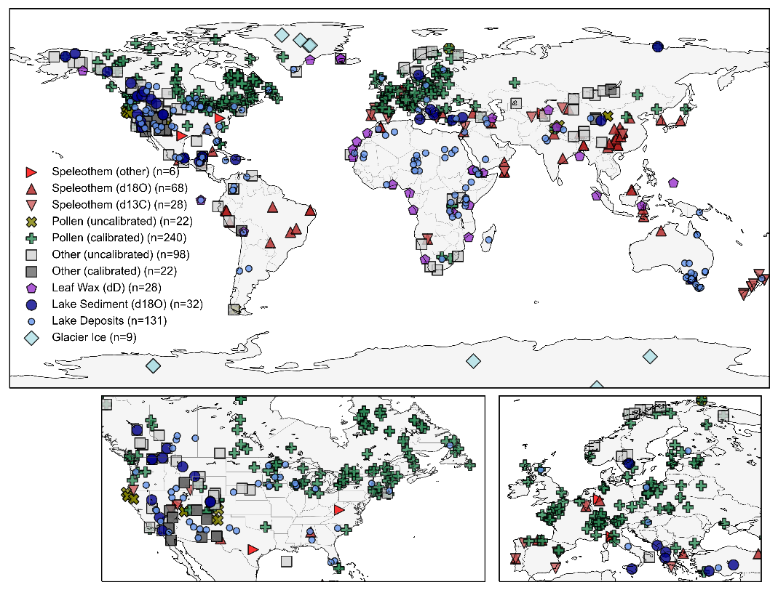
Notes:
Need to talk with cody about revising categories and match symbology with wNA
Add (n=) to legend

Slide 7
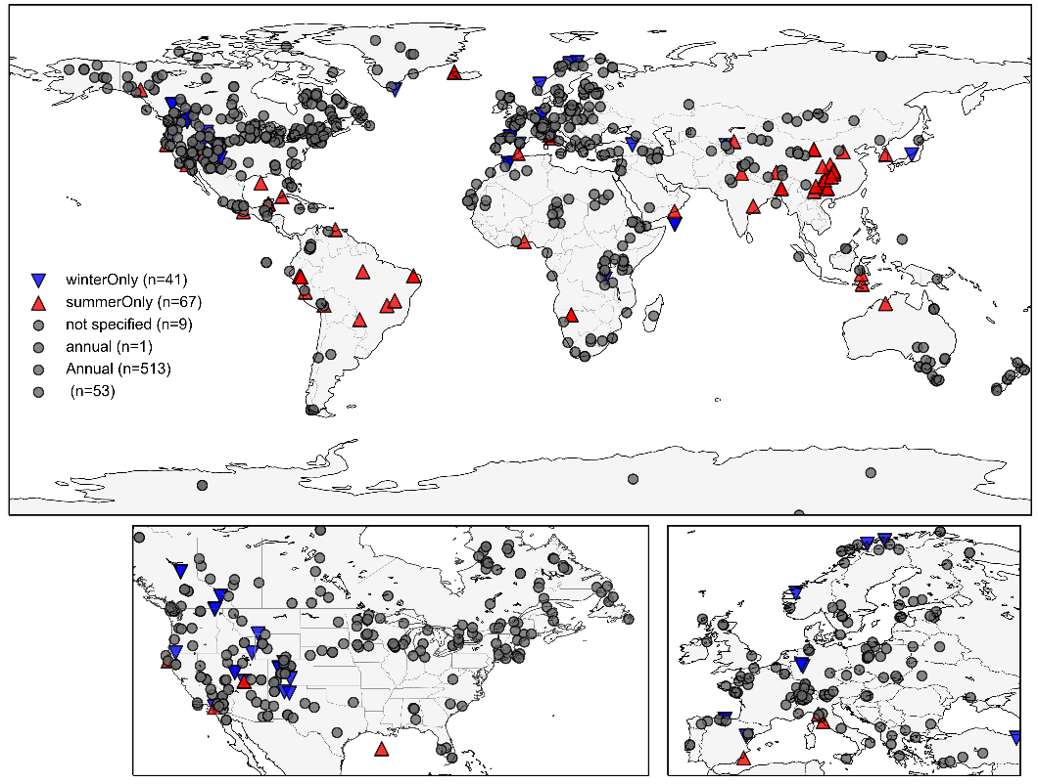
Notes:
Need to talk with cody about revising categories and match symbology with wNA
Add (n=) to legend

Slide 8
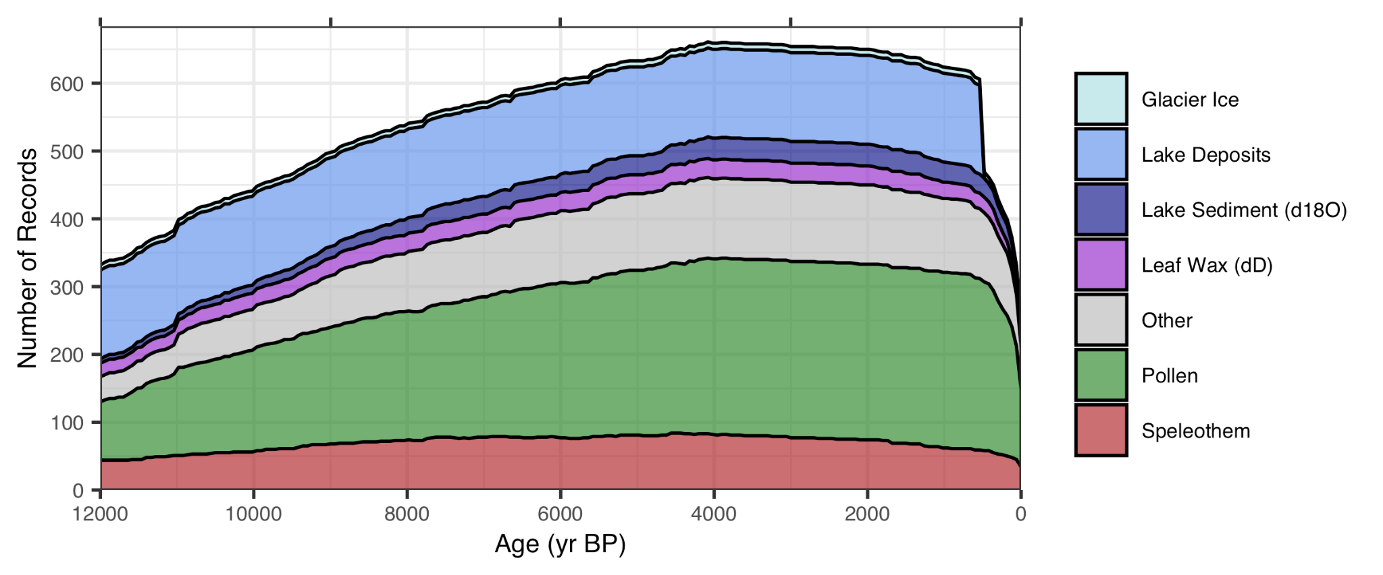

Slide 9
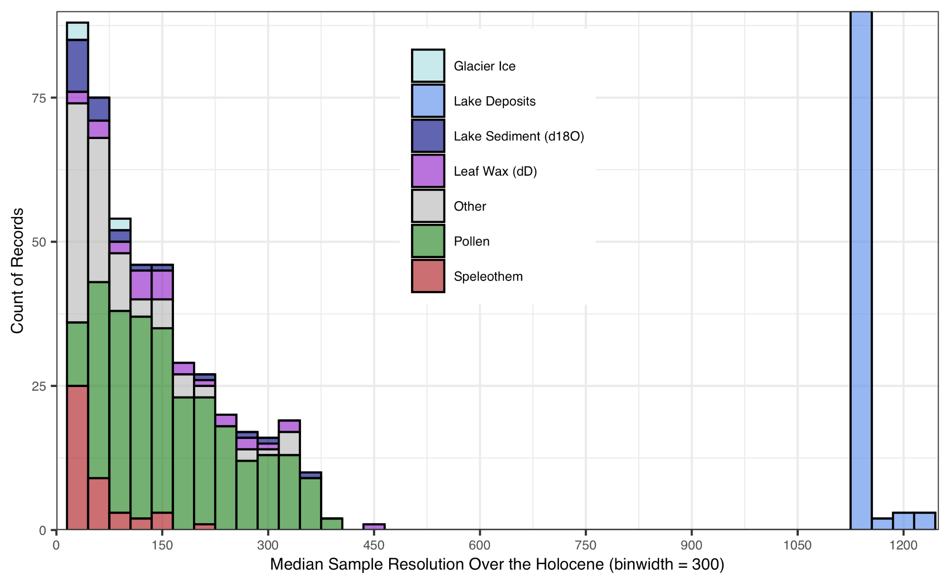

Slide 10
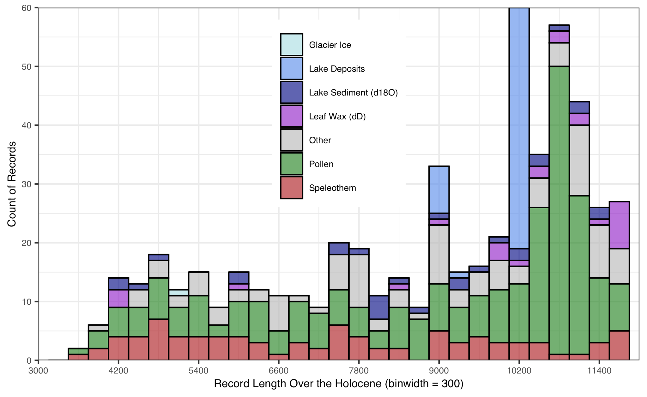

Slide 11
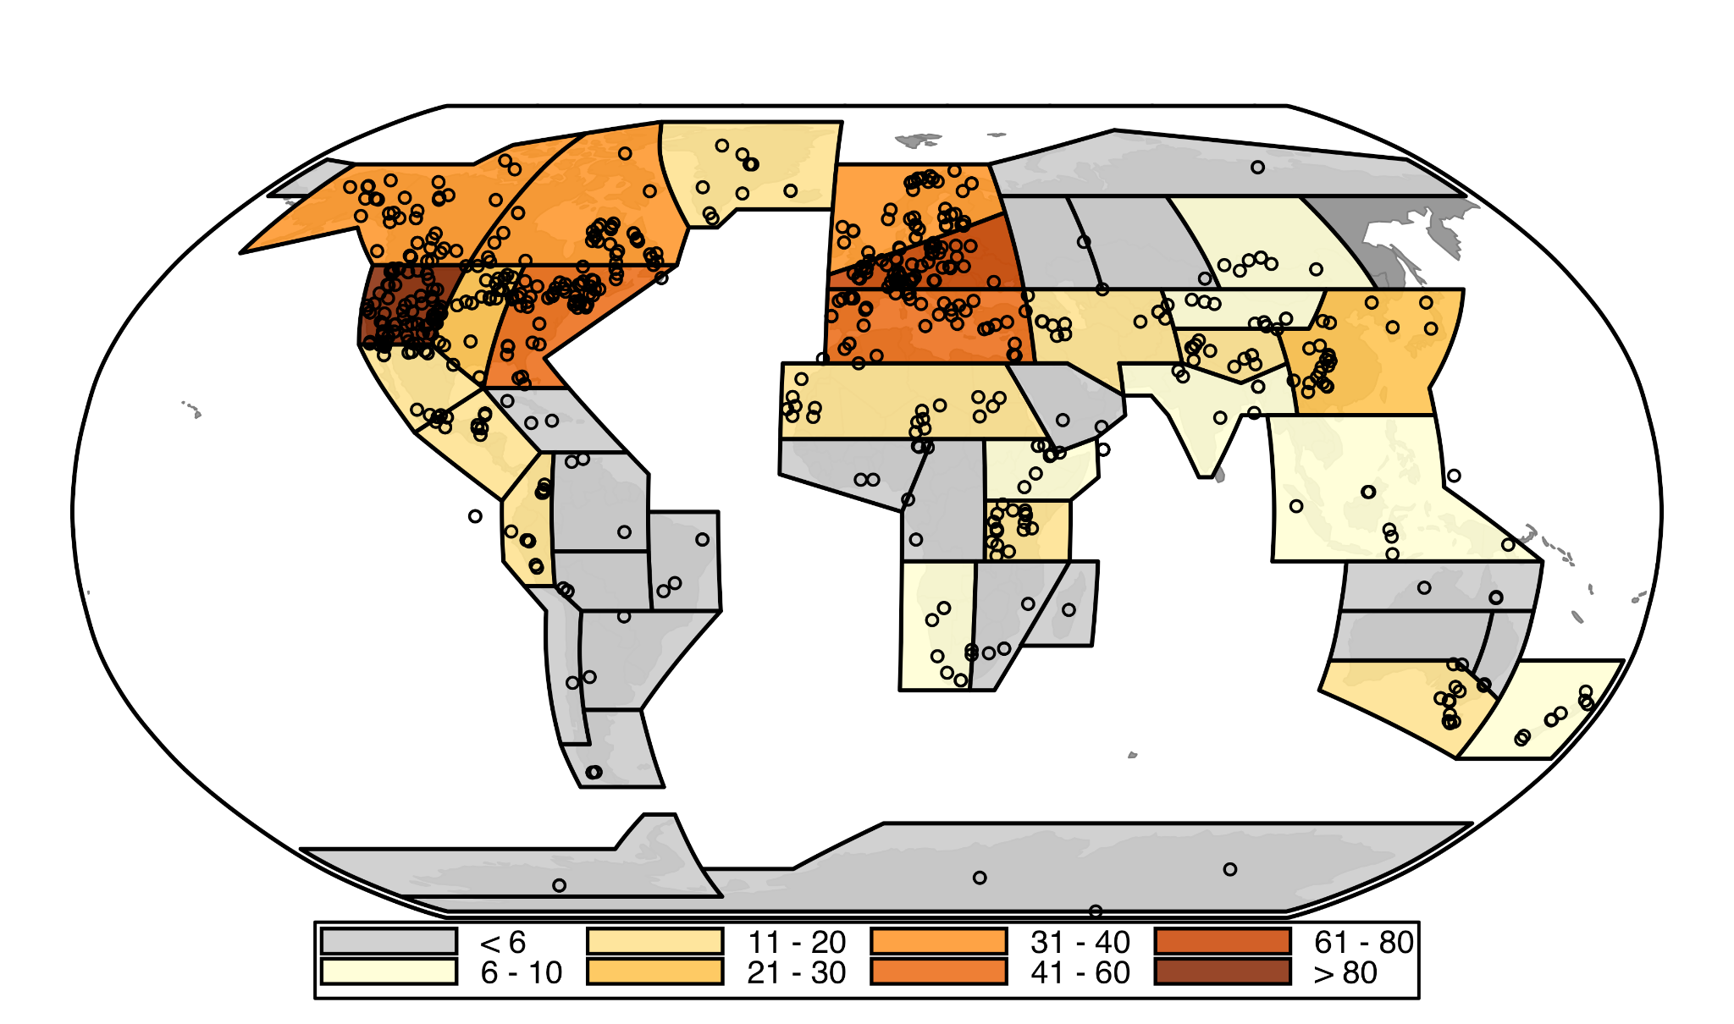
Number of proxy records within each region
Notes:
(Symbol = 6ka-0ka)?
Advantages:
don’t change when adding/removing data
Temperature and Hydroclimate regions can be the same
Script can flow smoothly in python without having to switch to device with ArcGIS pro
2) Less arbitrary / no parameters I select
3) translate to other research

Slide 12
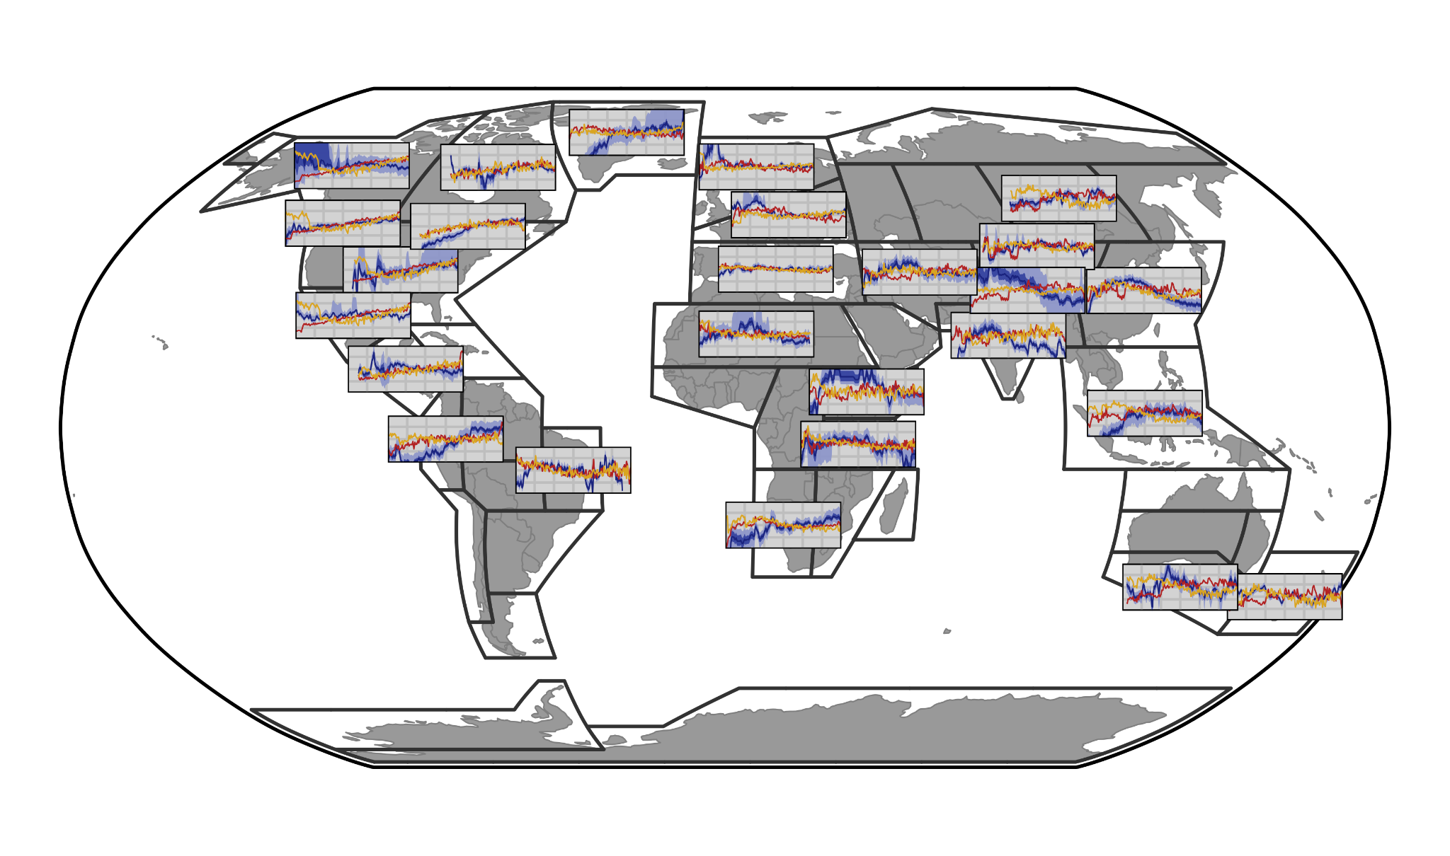
Notes:
Model data standardized. How does that compare to range of change? Does bigger range of Pann change -> better proxy agreement
Red = Trace
Yellow = HadCM

Slide 13
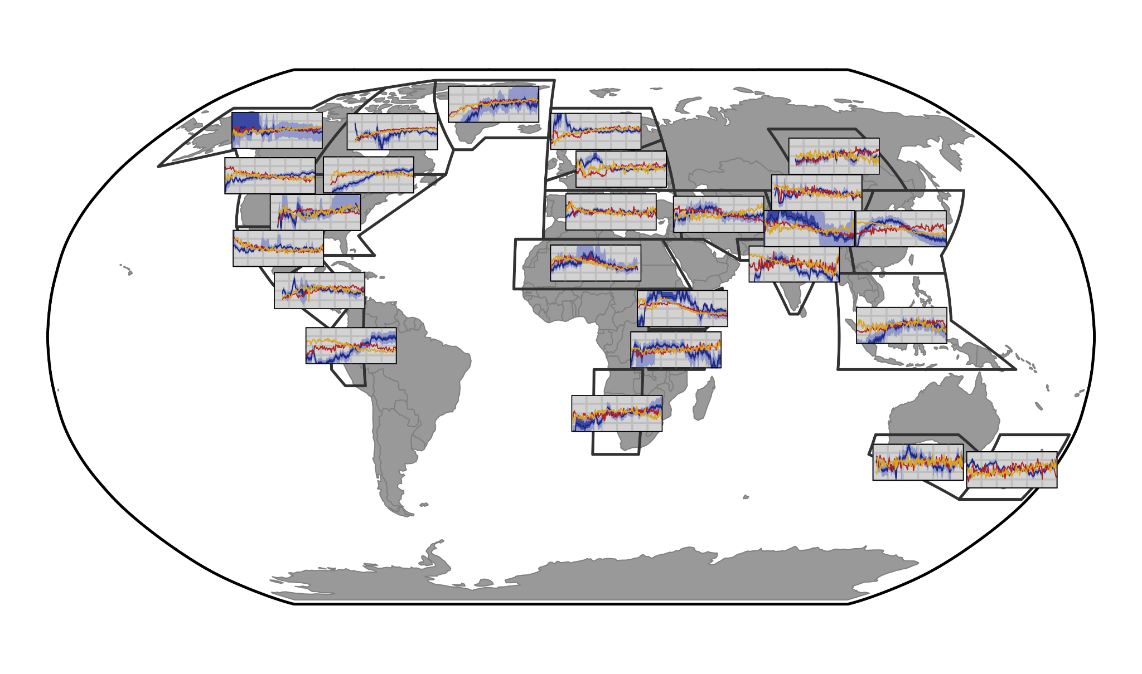
Notes:
Model data standardized. How does that compare to range of change? Does bigger range of Pann change -> better proxy agreement
Red = Trace
Yellow = HadCM

Slide 14
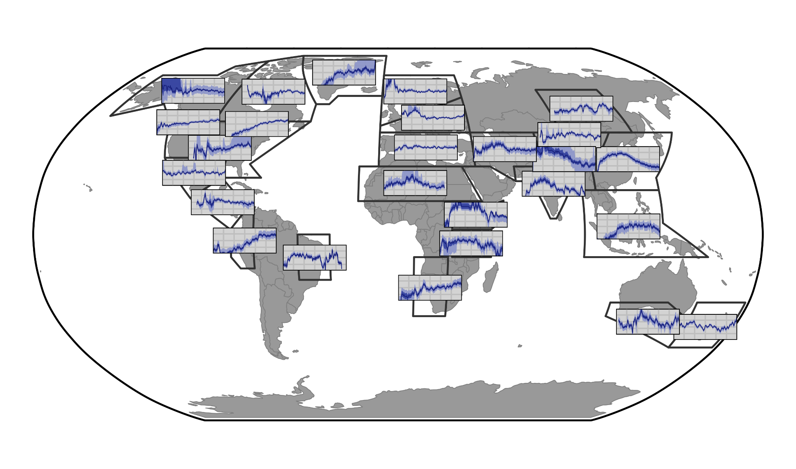

Slide 15
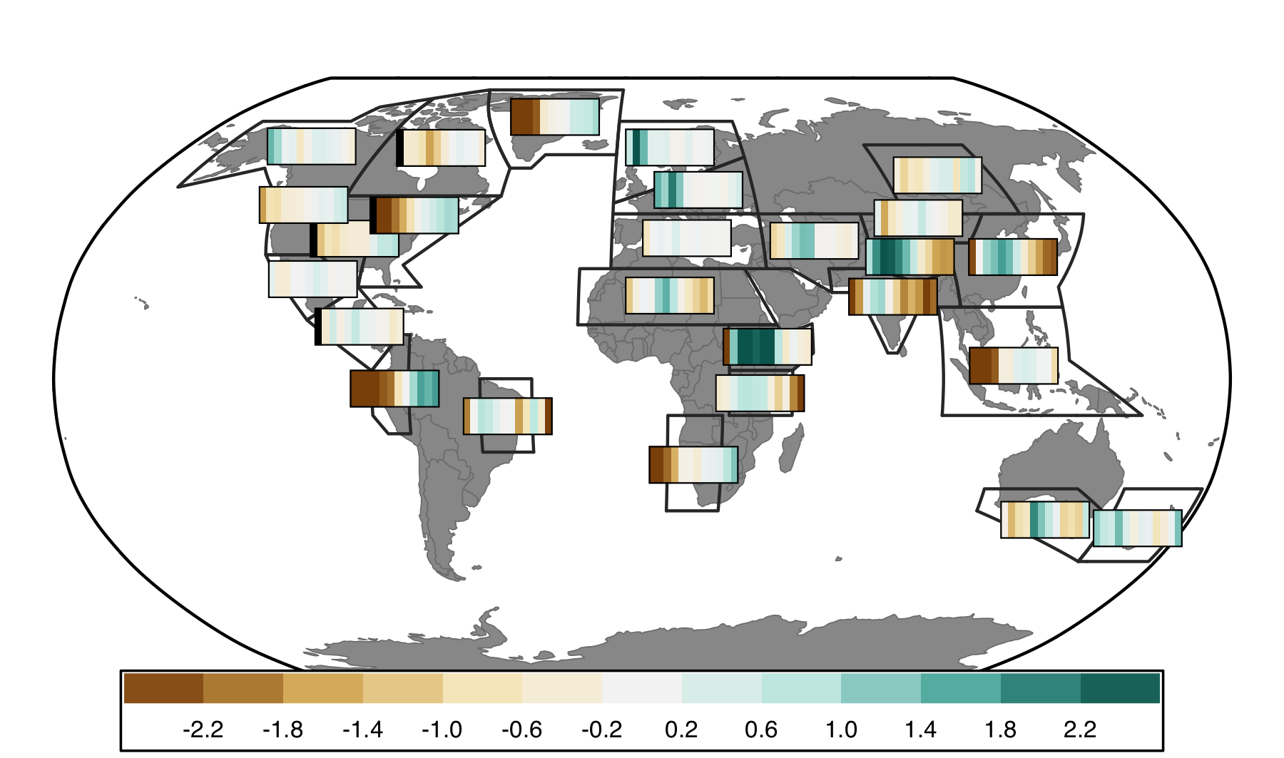

Slide 16
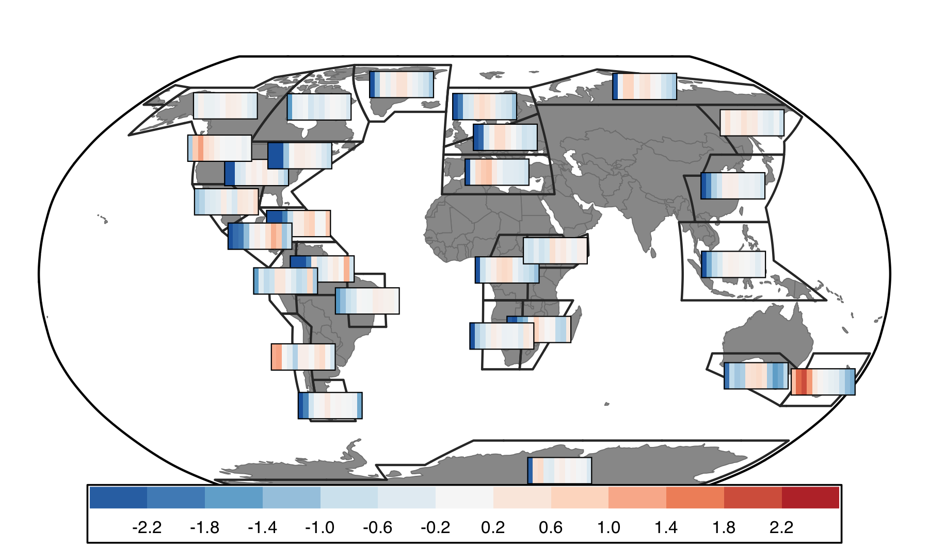

Slide 17
Next Steps:
Decide what I want to say
Proxy-model agreement == model-model agreement
Do regions with agreement reflect more signal (greater magnitude changes
Monsoon signal more widespread in proxy data than models
Similar agreement with late Holocene Temperature

Slide 18
Next Steps:
Clean up metadata (publication)
Write manuscript
Data Assimilation

Slide 20
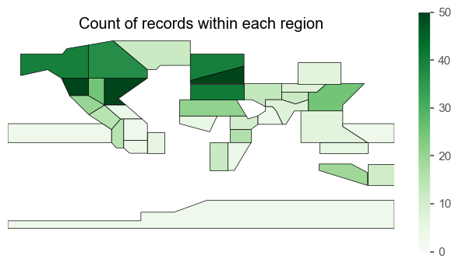
Or could use IPCC

Slide 21
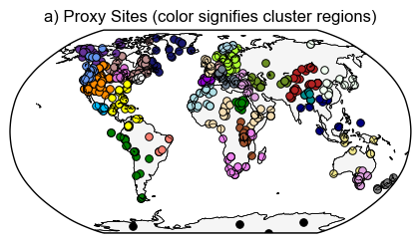
Figure 3: Cluster results
Notes:
R2 values: check from arcgis output

Slide 22
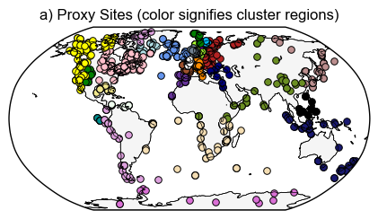
temperature
Notes:
Colors based on HC cluster # so will change to better distinguish neighboring clusters (pacific South America and Antarctica / 2 in Australasia)

Slide 23
Notes:
(Min of 3)

Slide 24
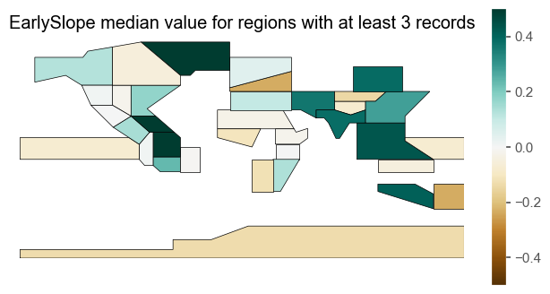
Notes:
(Min of 3)

Slide 25
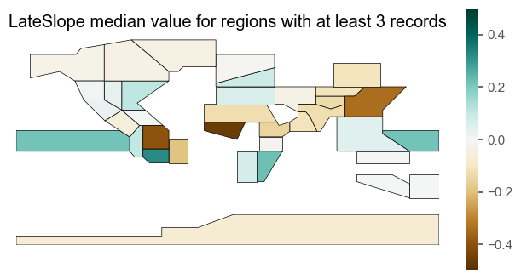
Notes:
(Min of 3)

Slide 26
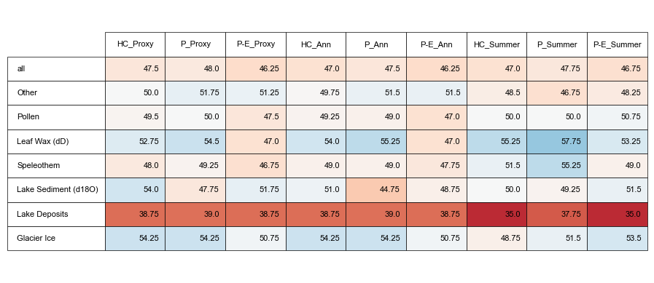
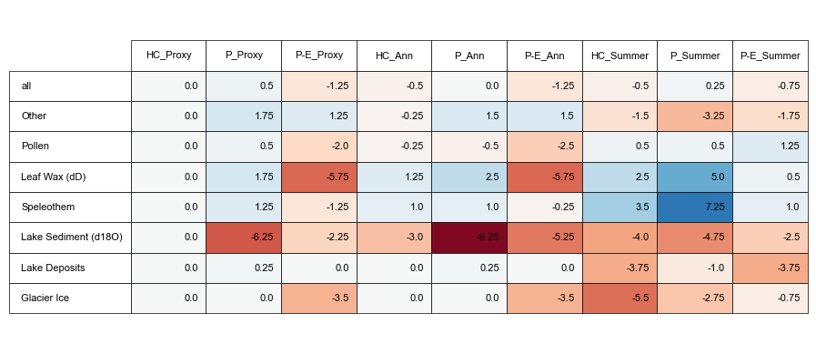
Notes:
Comparisons of how proxies (hydroclimate) compare with model pseudoproxies based on various assumptions about proxy climate interpretation (proxy metadata vs all P vs all P-E) and seasonality (proxy metadata vs assume annual are summer vs assume all are summer)
Top: Absolute %
Bottom: Difference between assumption test and using proxy metadata for both assumptions (1st column)

Slide 27
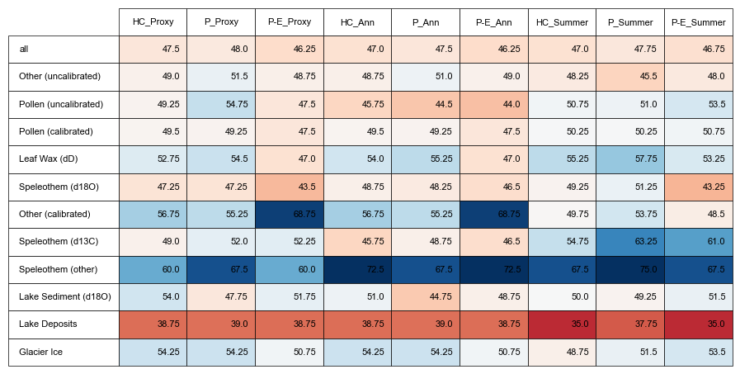

Slide 28
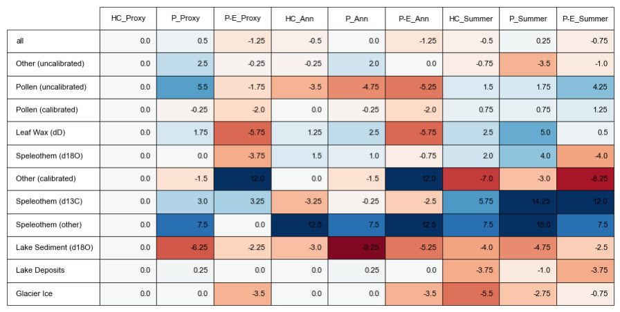

Slide 29
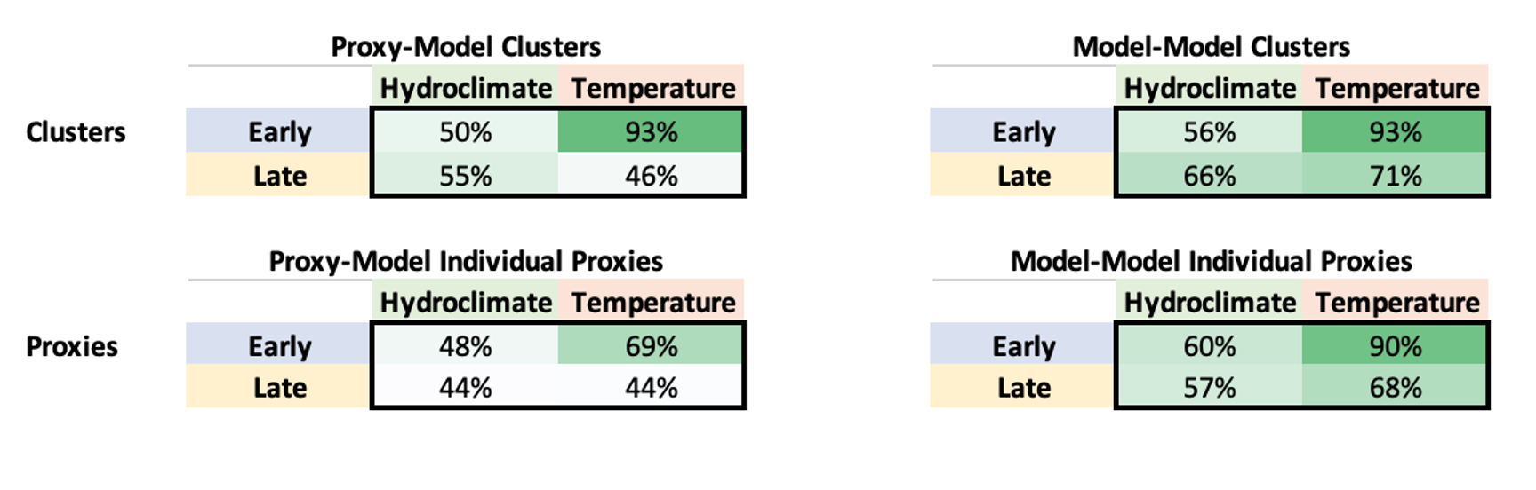

Slide 30
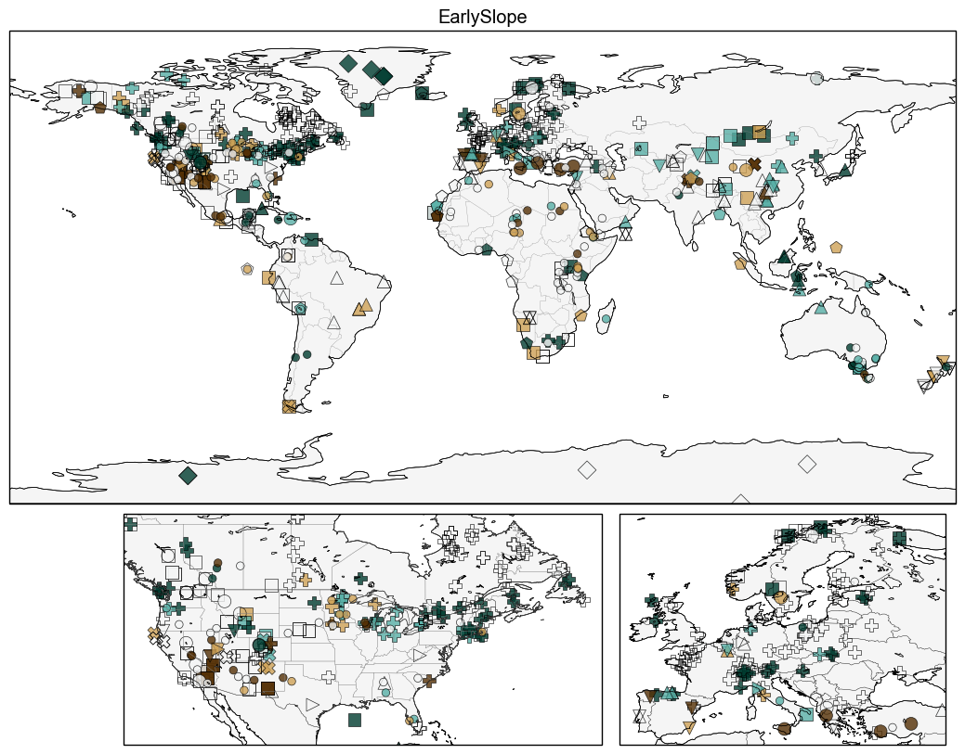
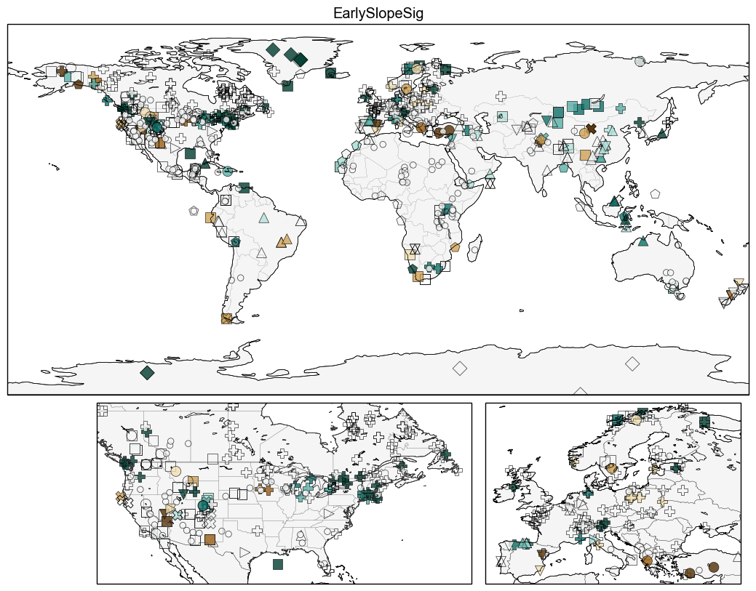

Slide 31
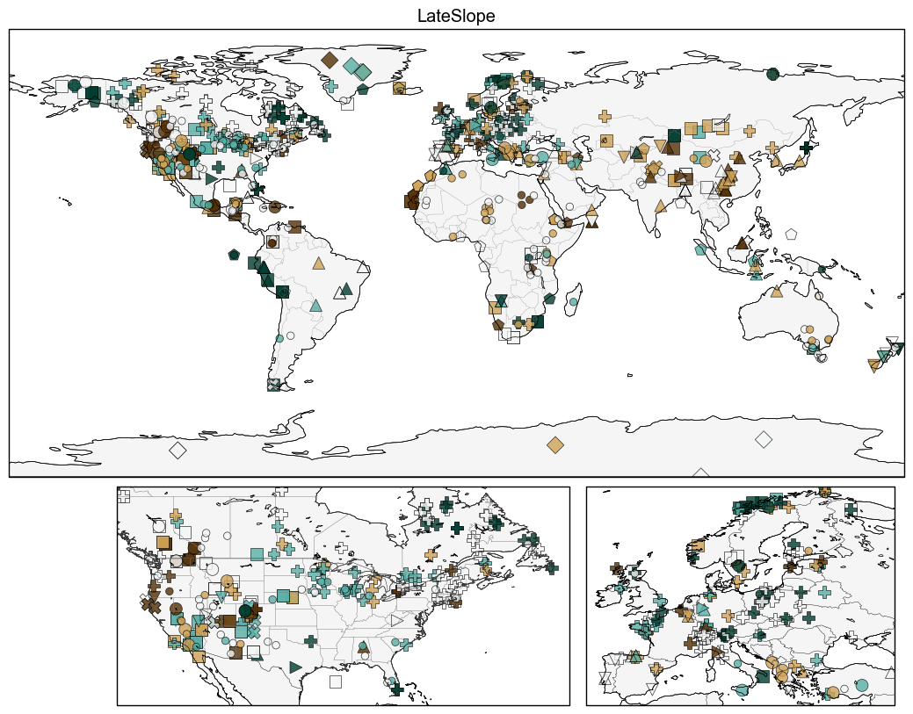
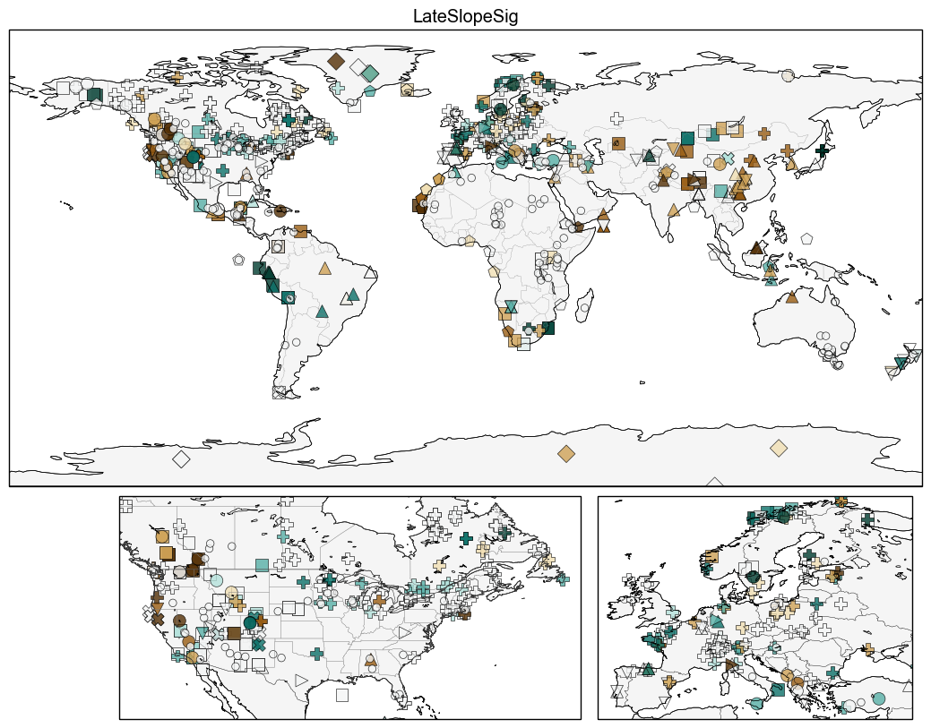

Slide 32
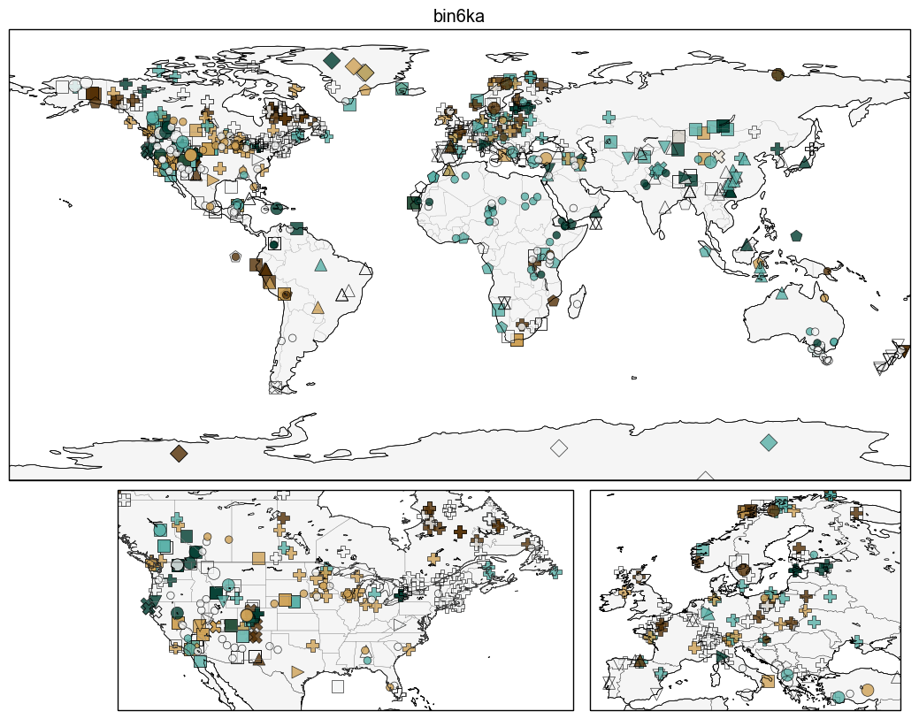

Slide 33
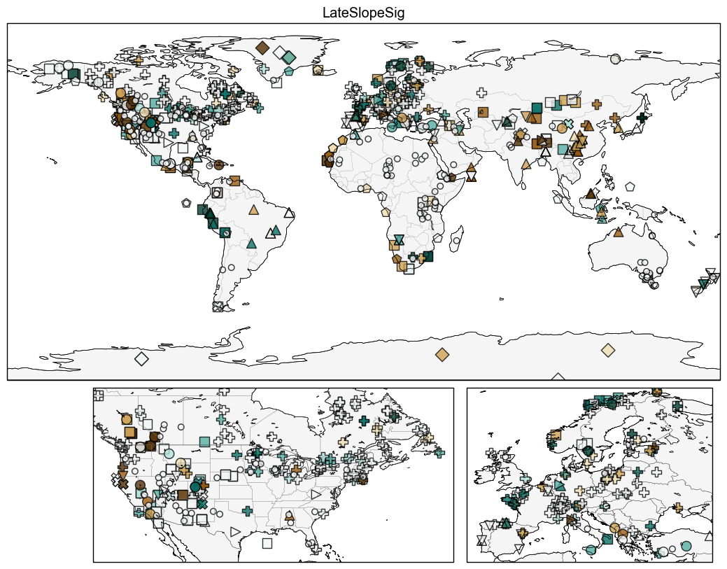

Slide 35
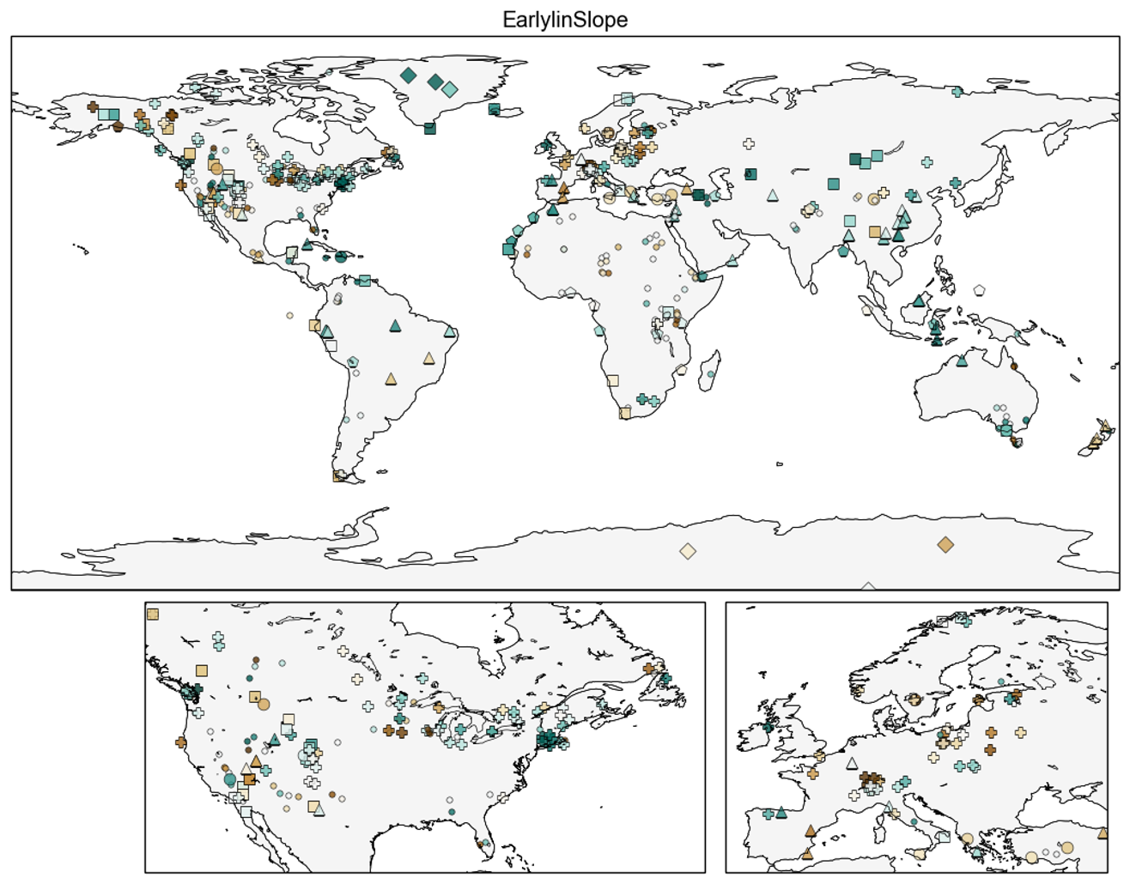

Slide 36
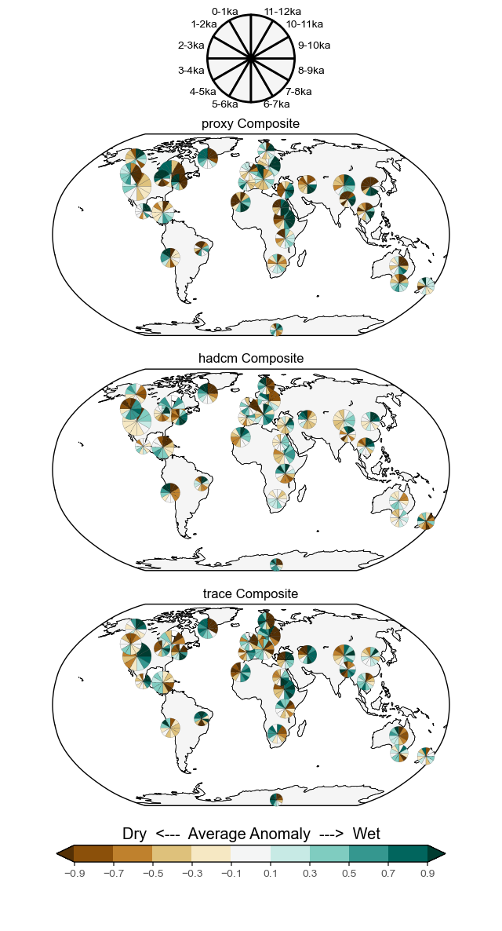
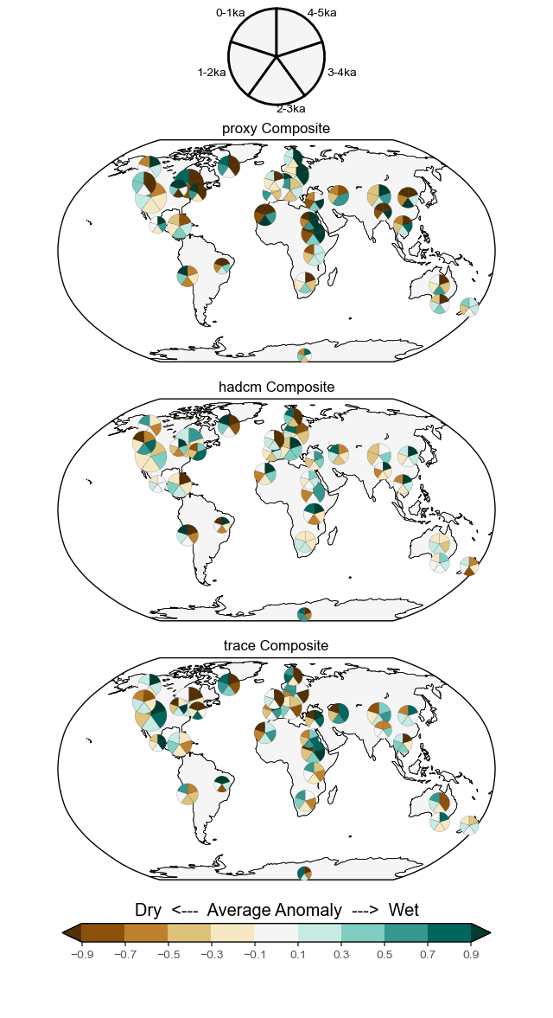

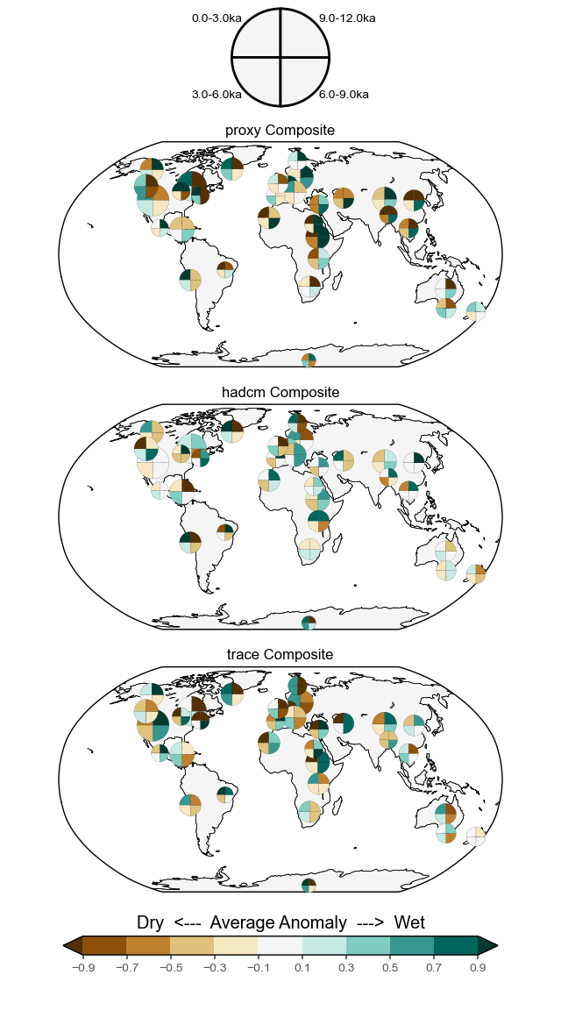

Notes:
Mean value for each timebin. Timeseries standardized over entire Holocene.

Slide 37
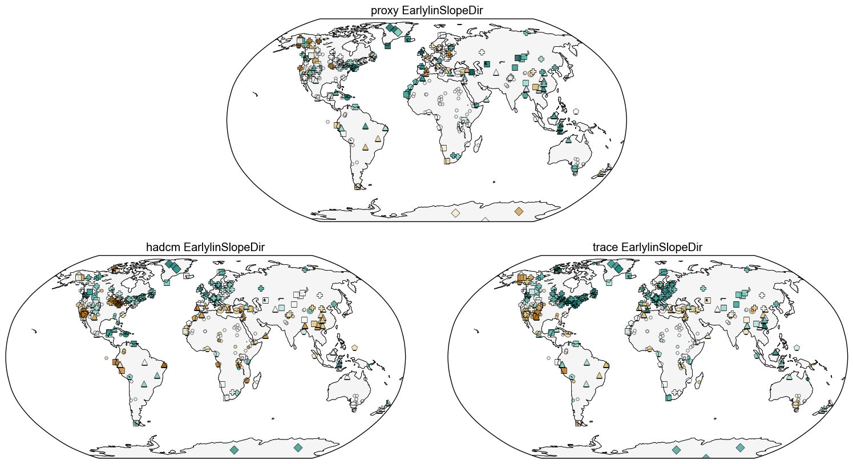

Slide 38
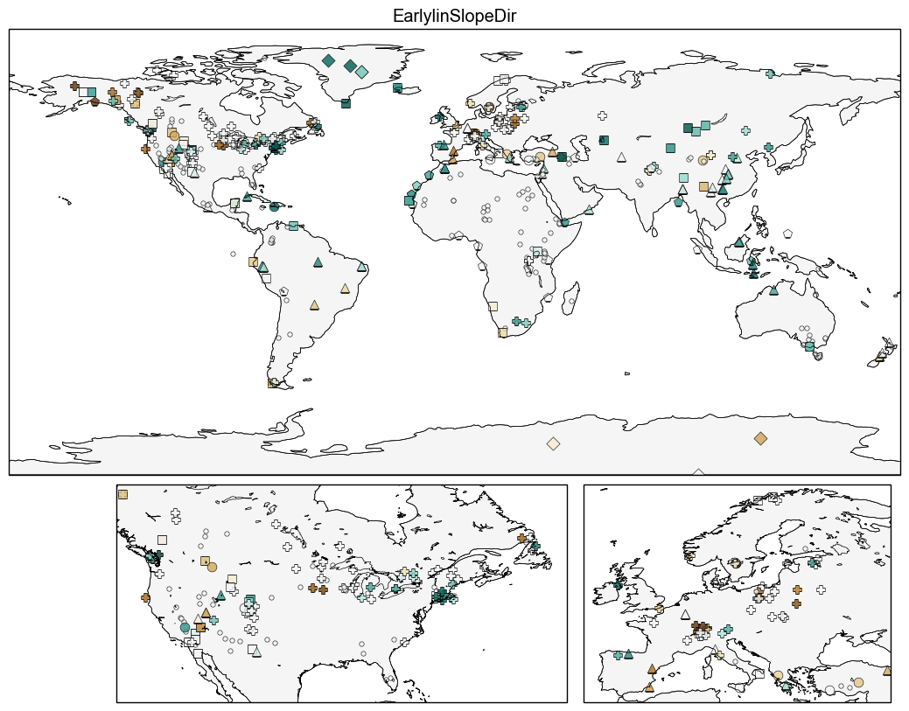

Slide 39
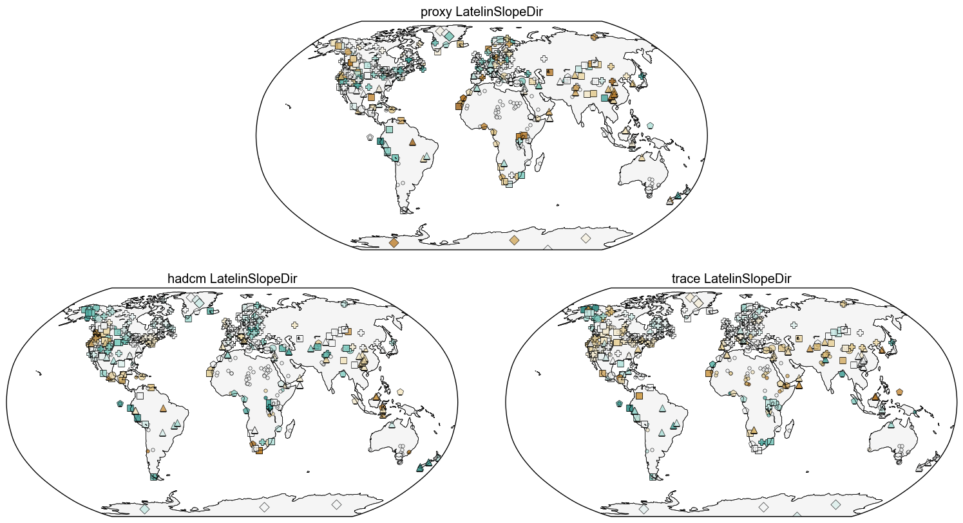

Slide 40
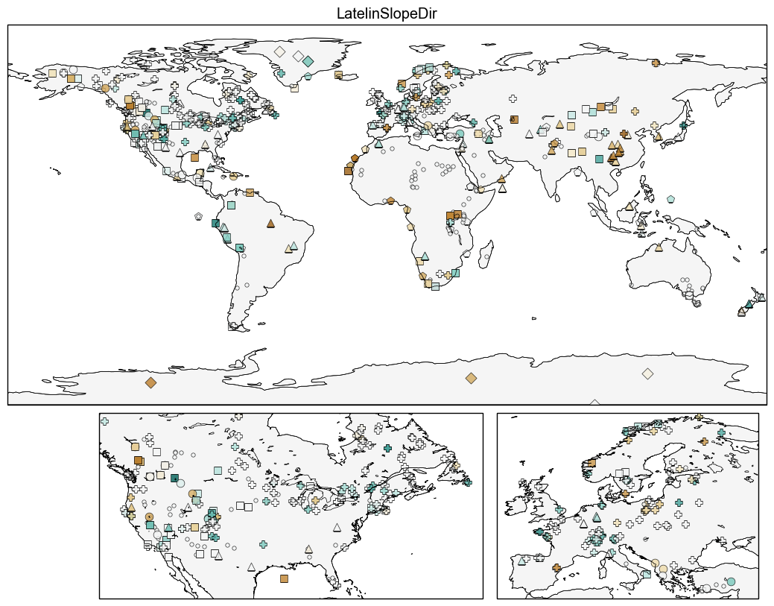

Slide 41
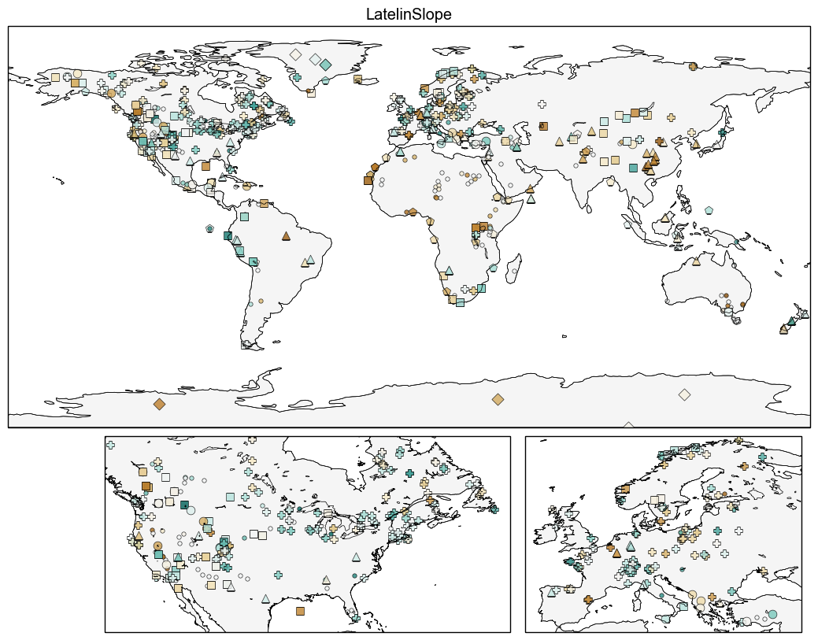

Slide 42
